Slide 1


Case Study: The Network Layer (IP) of the OSI Model
This presentation explores the network layer (IP) within the OSI model. We'll examine IP addressing, protocols, and routing algorithms. Discover how data finds its path, and learn troubleshooting techniques.
by Amit Valand

Slide 2
Introduction to the OSI Model and the Network Layer
The OSI model standardizes communication functions. This helps understand network interactions.
OSI Model Overview
Network Layer (Layer 3)
The OSI model consists of seven layers. Each layer performs specific network functions.
Responsible for routing data packets. It determines the best path across networks.

Slide 3



IP Addressing: IPv4 and IPv6 Explained
IP addresses are unique identifiers for devices on a network. IPv4 and IPv6 are the main versions.
IPv4
Uses 32-bit addresses. Limited address space leads to address exhaustion.
IPv6
Uses 128-bit addresses. Vastly expanded address space to solve exhaustion.

Slide 4
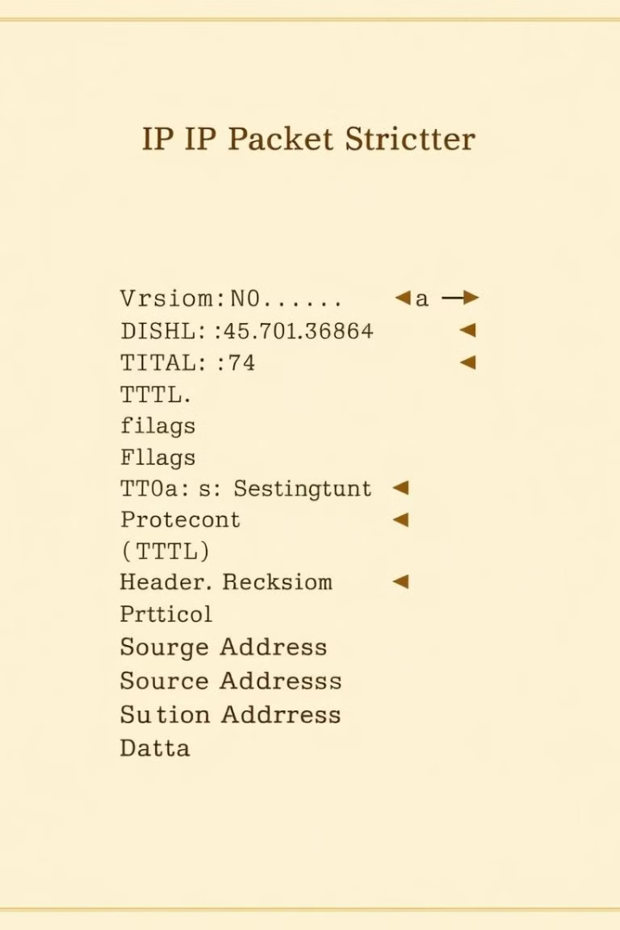



Network Layer Protocols: A Deep Dive into IP
The Internet Protocol (IP) is fundamental. It enables communication across networks.
IP Protocol
Key Functions
IP Security
Connectionless protocol. Delivers data packets independently.
Addressing, routing, and fragmentation of data packets.
IPsec provides secure communication channels at the network layer.

Slide 5



Routing Algorithms and Protocols: How Data Finds its Path
Routing algorithms determine optimal paths for data transmission.
Link State
2
Broadcasts network topology.
Distance Vector
1
Shares routing table with neighbors.
Path Vector
3
Combines features of both algorithms.

Slide 6




Case Study: Analyzing Network Packet Traversal
Consider a data packet traveling from a client to a server.
Client
Packet originates from the client device.
Router
Packet routed through multiple routers.
Server
Packet arrives at the destination server.

Slide 7
Common Network Layer Issues: Troubleshooting and Solutions
Addressing and routing problems are common. Understanding these issues enables quick solutions.
IP Conflicts
1
Ensure each device has a unique IP.
Routing Loops
2
Configure routing protocols correctly.
Firewall
3
Configure firewall rules.

Slide 8

Conclusion and Key Takeaways
The network layer is crucial for modern communication. Mastering IP addressing, protocols, and troubleshooting boosts network efficiency.
IP Essentials
Routing Insights
IPv4 and IPv6 addresses enable device identification.
Routing algorithms determine optimal data paths.
Problem Solving
Troubleshooting skills improve network performance.

